Slide 1
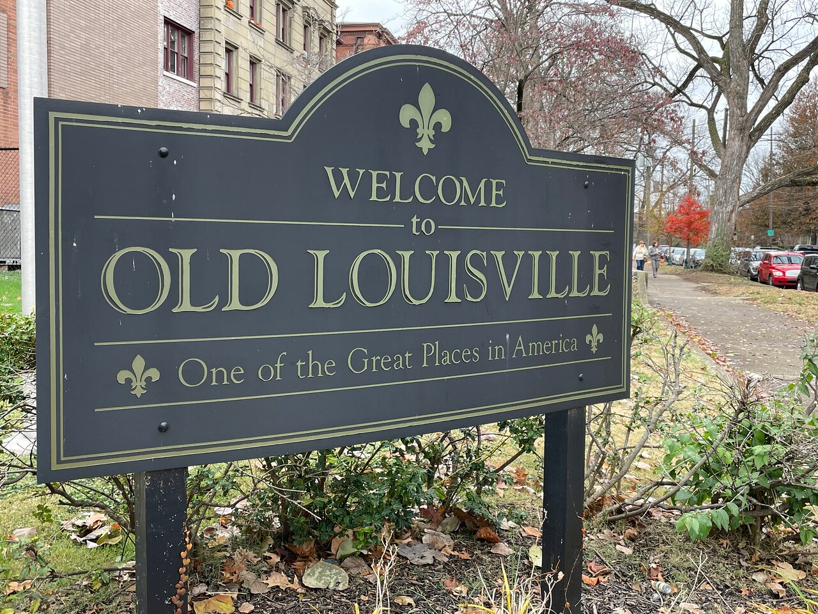
Old Louisville Neighborhood Council Planning Discussion
1/23/2025
Brian Davis
Michael King
Joe Haberman
John Hawkins

Slide 2
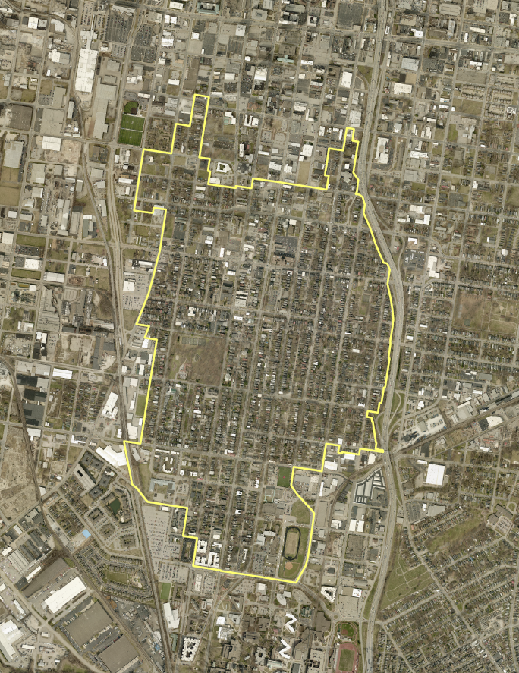
Traditional Neighborhood Zoning District (TNZD)
8th St
Zoning designation designed to recognize historic or long-established traditional neighborhoods and to protect them as a distinct pattern of development.
Old Louisville is only TNZD in Jefferson County
Adopted November 2002
557 Acres of land in TNZD
Generally located between Kentucky Street, UL, I-65 and 7th Street
Kentucky St
Hill St
Cardinal Blvd
Brook St

Slide 3
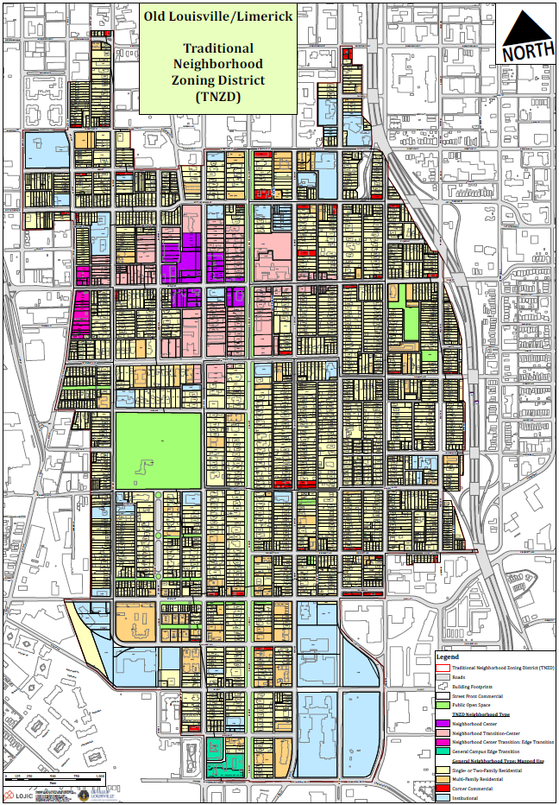
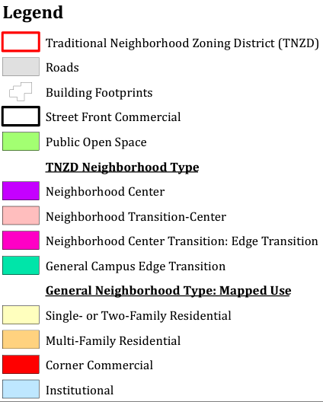
Traditional Neighborhood Zoning District (TNZD)
TNZD has 5 components
Neighborhood Center
Neighborhood Transition-Center
Neighborhood General
Neighborhood Center Transition: Edge Transition
Neighborhood General Campus Edge Transition
Each component has defined land uses with “Neighborhood General” identifying land use by parcel
Some amendments to TNZD may be made by property owner
All other amendments are initiated by the Planning Commission or Metro Council

Slide 4
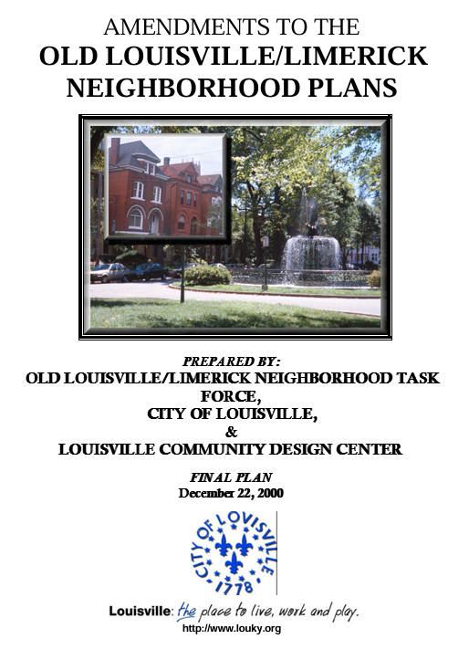
Neighborhood Plan
Old Louisville/Limerick Neighborhood Plan
Adopted 2000
Executive Summary adopted as amendment to Cornerstone 2020 and Plan 2040
Same Study Area as TNZD
Planned for land use, mobility and open space
“Old Louisville/Limerick will be a vital, safe, attractive neighborhood that reflects its historic character and achieves its rightful place as being home to Louisville’s “choicest addresses” in the economic, civic, and cultural life of this community.
Created TNZD zoning along with associated land uses and form

Slide 5
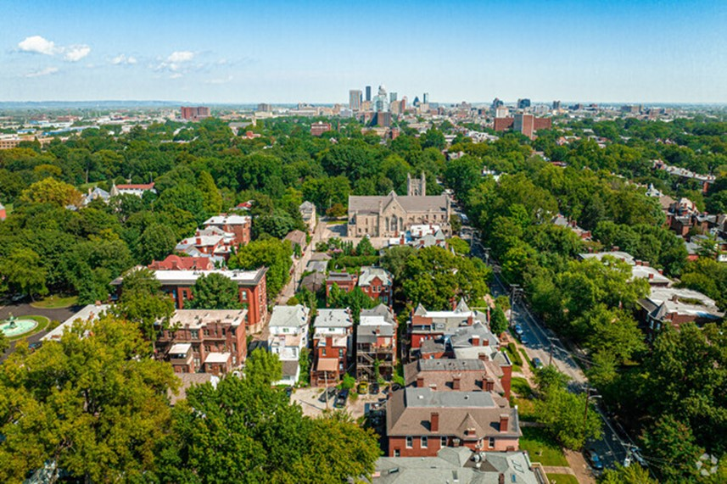
Neighborhood Plans Today
Introduction
Vision Statement
Neighborhood Identity Section
Mandatory Components
Land Use/Community Form
Mobility
Housing
Optional Components
Plan Implementation Section
Executive Summary

Slide 6
NEIGHBORHOOD PLANS

Slide 7
How is Group Housing Regulated?
State law (KRS)
Local zoning regulations/Land Development Code (LDC)
Local ordinance/Louisville Metro Code of Ordinances (LMCO)
State and local building and life safety codes
Guidelines and standards required by agencies and organizations

Slide 8
Overview of Current Louisville Metro Code of Ordinance or LMCO Regulations
Requires annual license
Allows for an annual review and inspection by different agencies
Provides penalties for non-compliance with the LMCO provisions

Slide 9
Overview of Current Louisville Metro Zoning Regulations (Land Development Code)
Defines and differentiates types of group housing
Regulates where different types of group housing can and cannot be located (by zoning district)
If permitted, provides 1 of 3 processes for approval
By right (non-discretionary, allowed without any public hearing or special approval
By right with special standards (non-discretionary, allowed without any public hearing or special approval if stated standards are met)
By Conditional Use Permit (discretionary, approved or denied following a public hearing)
Provides penalties for non-compliance with the LDC provisions (consistent with state law)

Slide 10
Group Housing Zoning Regulations in the TNZD
The Old Louisville/Limerick TNZD zoning regulations were established in 2002 and last updated in 2016
The broader group housing zoning regulations have been established over time and notably updated in 2010 (transitional housing and homeless shelters), 2015 (boarding houses), and 2021 (all group housing types)

Slide 11
What is Regulated as a Type of Group Housing?
What is Not Considered Group Housing?
Boarding & lodging houses
Rehabilitation homes
Transitional housing
Recovery housing (not a defined use in the zoning code)
Multi-family dwellings (including long term rentals thereof)
Homeless shelters
Hotels, motels, and extended stay lodging
Bed and breakfast inns
Residential care facilities
Short term rentals
Assisted living, family care homes, hospitals, and nursing homes
Detention centers, jails, and prisons

Slide 12
Overview of Current Regulations for the Old Louisville / Limerick TNZD
Transitional Housing - permitted in any mapped area (CUP may be required)
Residential lodging house (a form of owner-occupied boarding house with 4 or fewer boarders) – permitted in any mapped area
Commercial boarding houses – permitted only in Center and Transition-Center (CUP always required)
Rehabilitation homes - permitted in any mapped area (CUP always required)

Slide 13
Transitional Housing in the TNZD
Permitted in any mapped area if all special standards are met
Allowed with a CUP if special standards cannot be met
Special standards relate to supervision/management, meeting all building and life safety codes, density, parking, and signage
CUP standards relate to compatibility and concentration, including a 1000’ separation requirement between group housing uses
CUPs may be revoked following complaints

Slide 14
Commercial Boarding Houses in the TNZD
Permitted only in Neighborhood Center and Transition-Center (as permitted in C2)
No longer permitted by right without any special standards
Limits to 8 boarders
CUP standards require own bedrooms, limit nonresidential uses and services unless otherwise permitted, and provide a 1000’ separation requirement between group housing uses
CUPs may be revoked following complaints
Residential lodging houses (a form of owner-occupied boarding house with 4 or fewer boarders) are permitted in any mapped area if standards are met

Slide 15
Rehabilitation Homes in the TNZD
Permitted only in any mapped area with a CUP
Continues to allow for 2 types, accommodations for occupants receiving supervised medical or professional care and occupants staying at the subject facility for supervised reentry as a condition of their parole
CUP standards limit homes in single-family residential zoning to 4 residents; limit homes in multi-family zoning to maximums determined by the BOZA, require appropriate 24-hour supervision and adequate support services for residents, and implement a 1000’ separation requirement between group housing uses
CUPs may be revoked following complaints

